Slide 1



PRESENTATION OF COMMENDATIONS
BY
H.E. GOVEROR PATRICK KETURET OLE NTUTU
  20TH DECEMBER, 2024
  20TH DECEMBER, 2024

Slide 2

01.
PAUL KITARI NAISESIA
This is to commend you for bravery, honesty, integrity and patriotism in the selfless discharge of your duties and surrender of the Kenya Wildlife Services (KWS) firearm that would have otherwise fallen into the wrong hands of bandits considering the volatility of Transmara region as far as skirmishes are concerned.

Slide 3
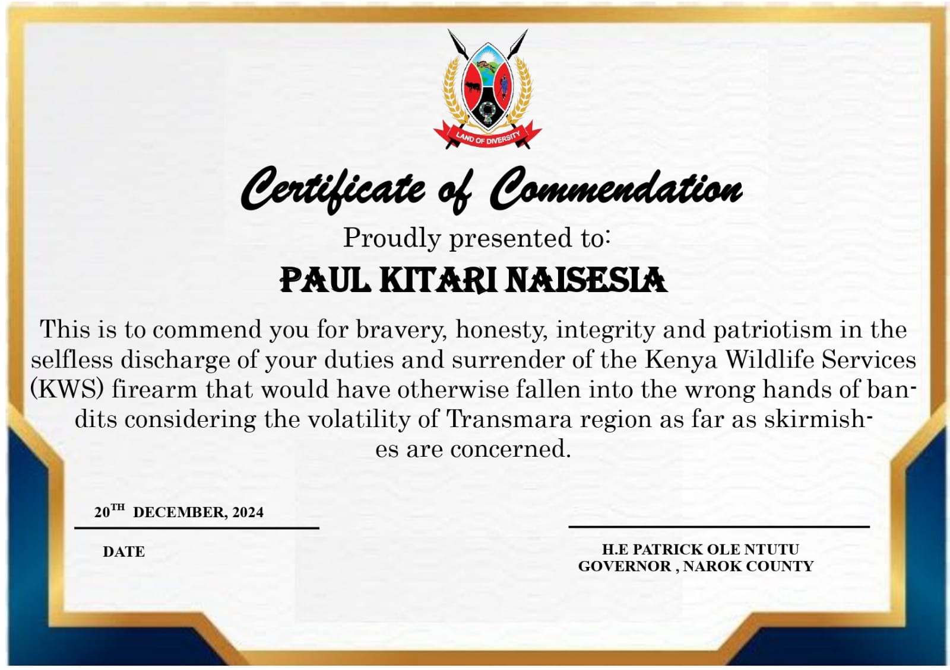

Slide 4
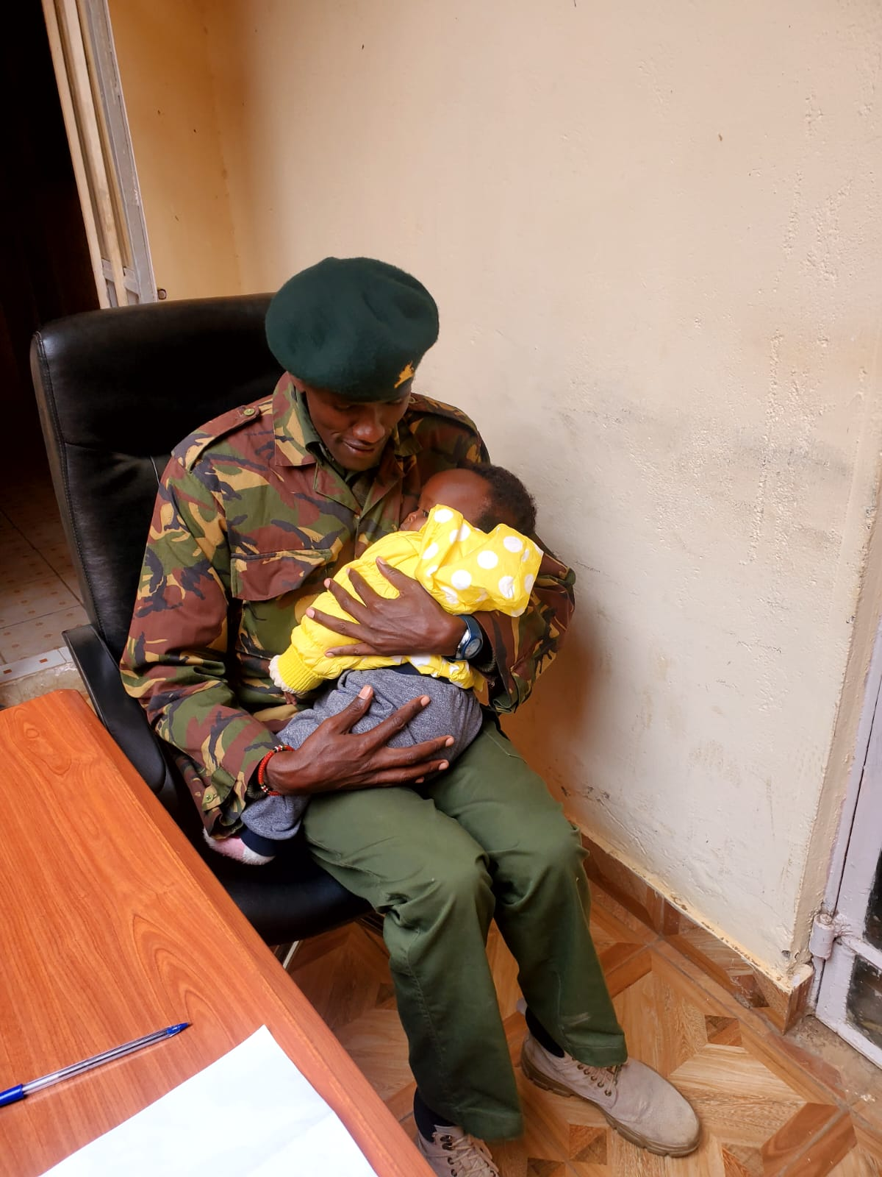
02.
PARKIRE LEMURT
This is to commend you for your gallant act of mercy that you extended to an interviewee who appeared before the Narok County Public Service Board for an interview on 23rd May, 2023 with an infant whom she could not leave at home due to unavoidable circumstances.

Slide 5
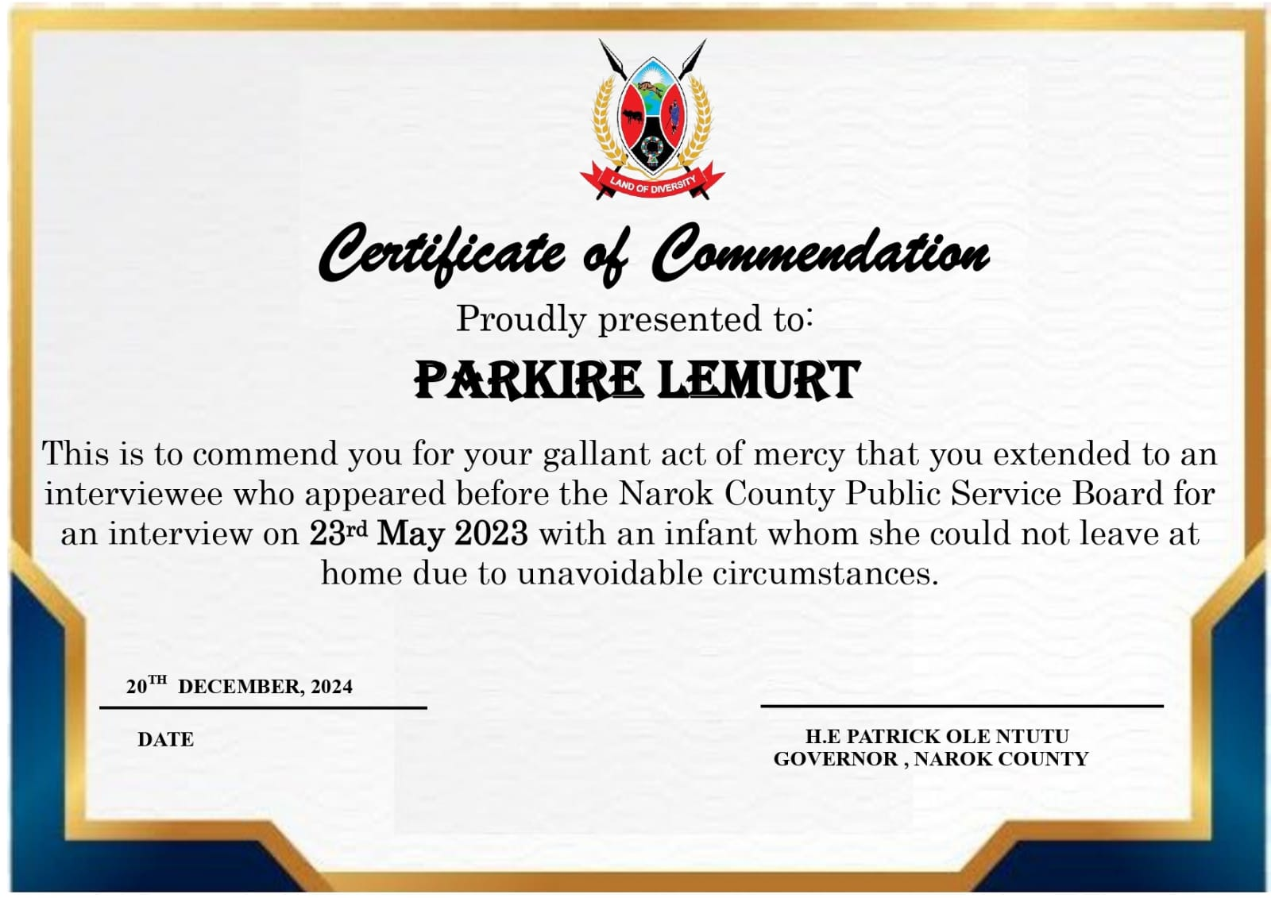

Slide 6
03.
ANN NAANYU OIYIE
This is to commend you for dedication, bravery, integrity and patriotism in the selfless discharge of your Nursing duties at Naisoyia Dispensary in Narok Central Sub-County. Your commitment to serving the community is truly

Slide 7
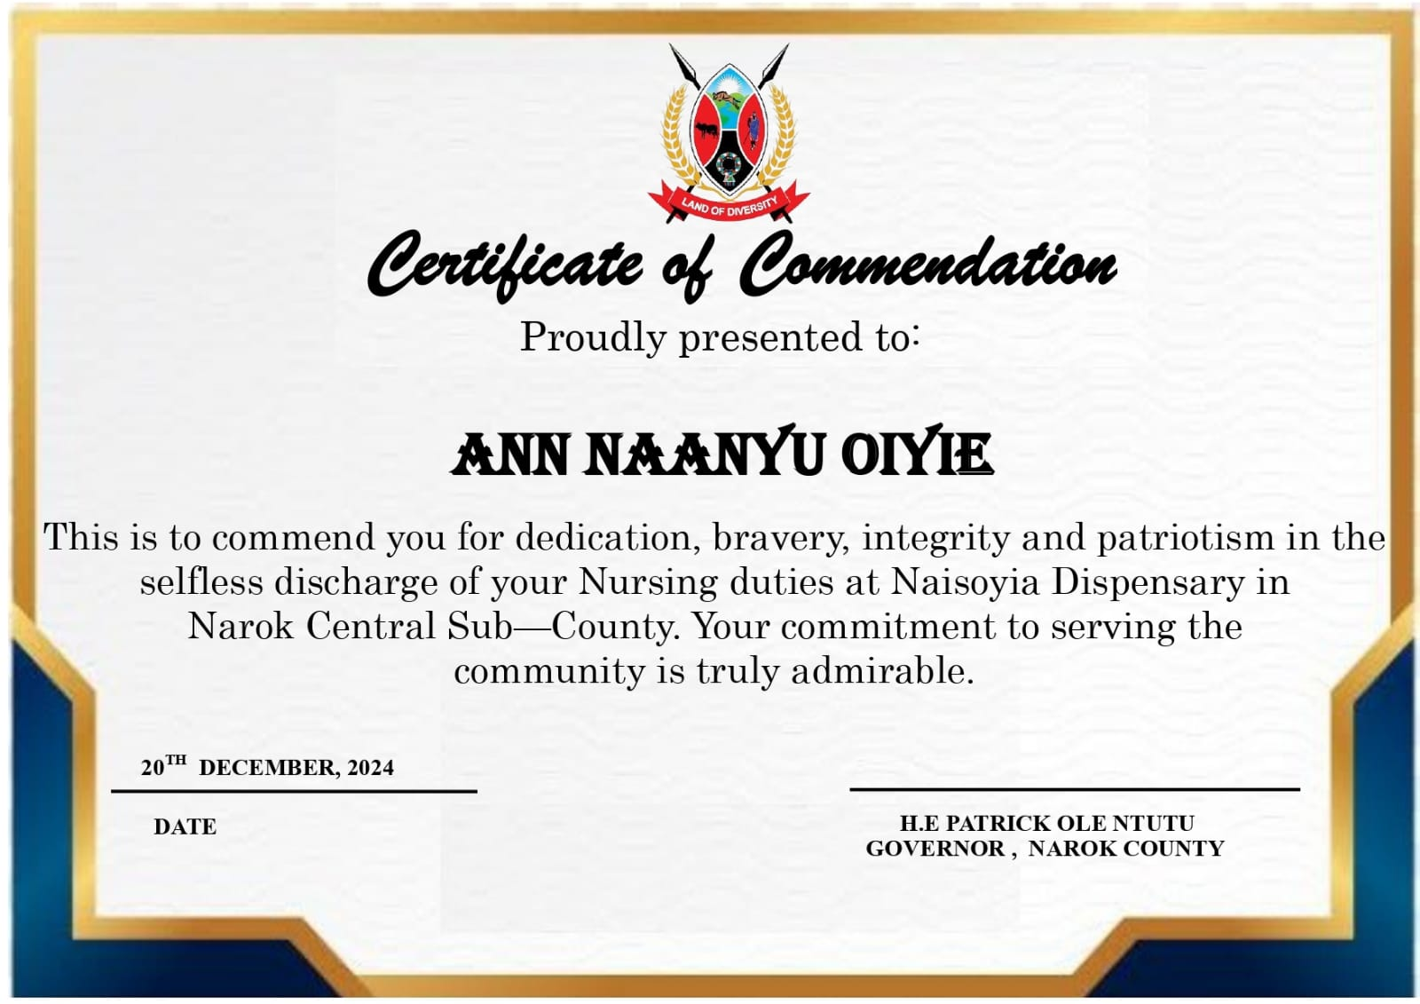

Slide 8
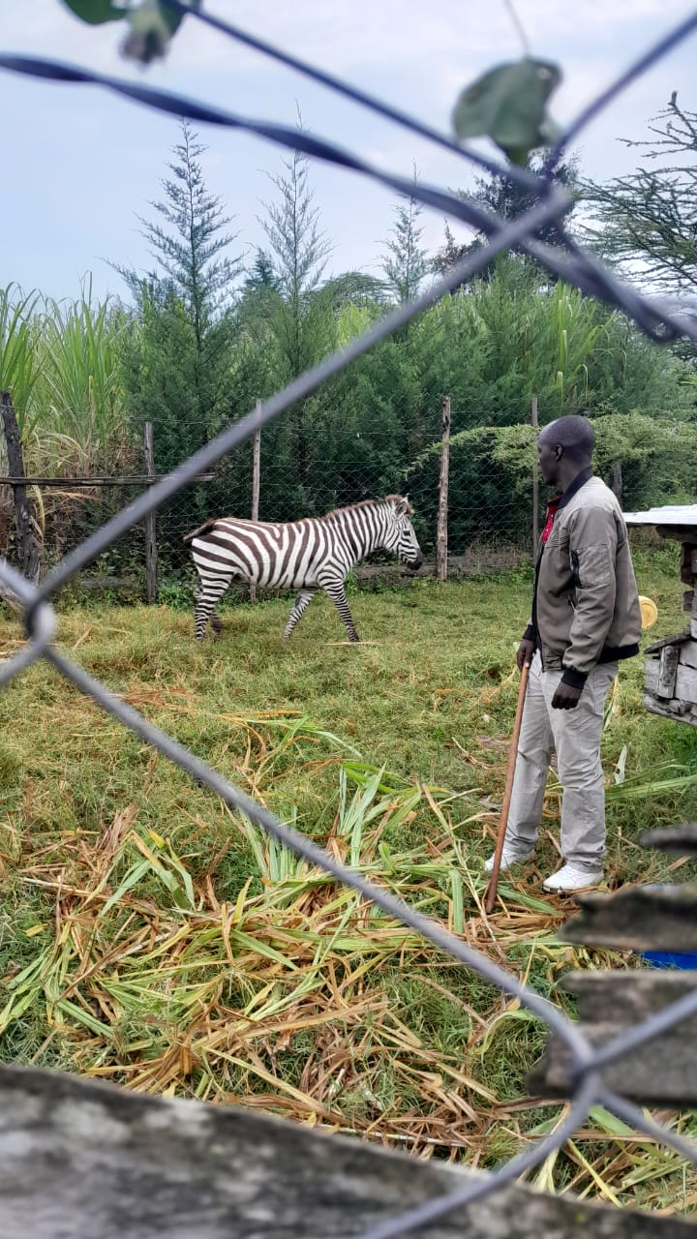
04.
BENARD YEGON
This is to commend you for bravery, honesty, integrity and patriotism in the selfless discharge of your duties that you displayed by saving a zebra that encroached into a community in Kilgoris and grazed in their farms where they wanted to kill it.

Slide 9
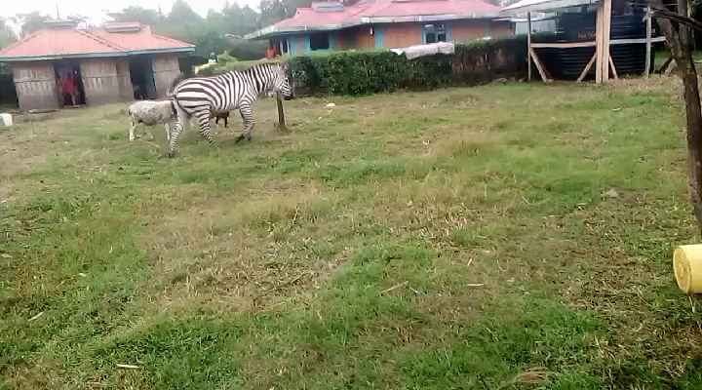

Slide 10
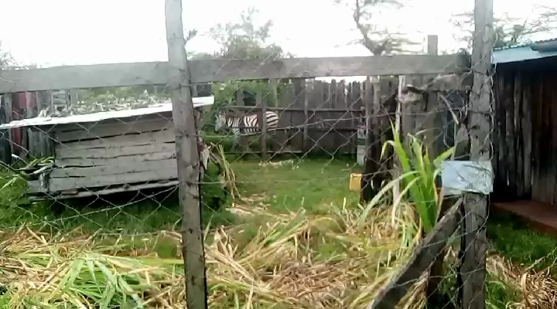

Slide 11
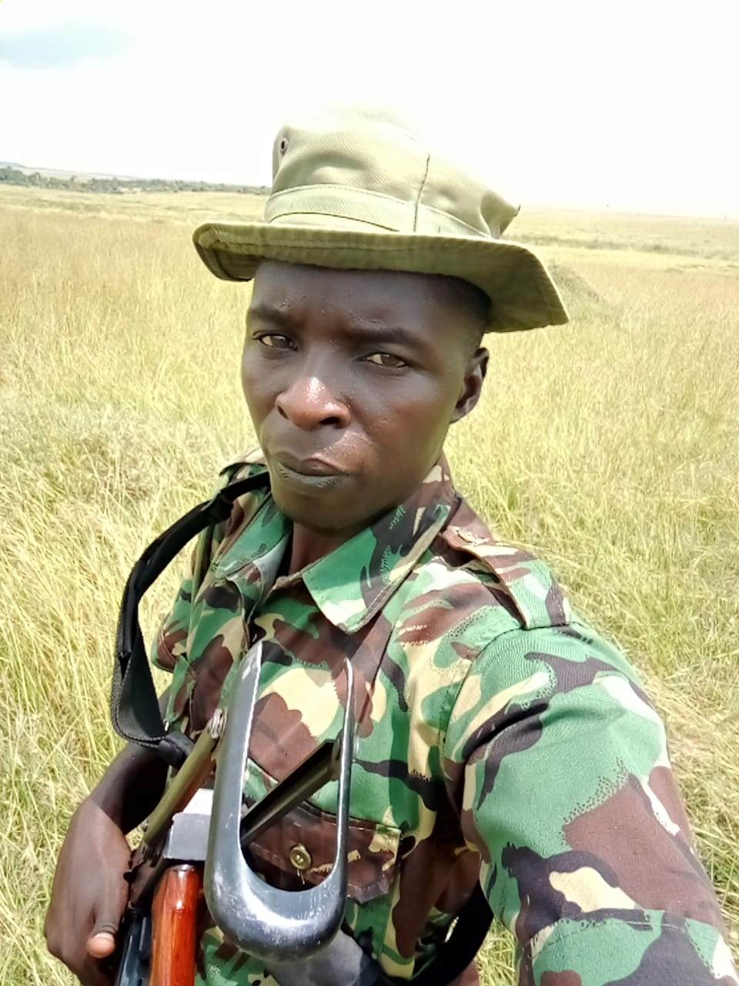

Slide 12
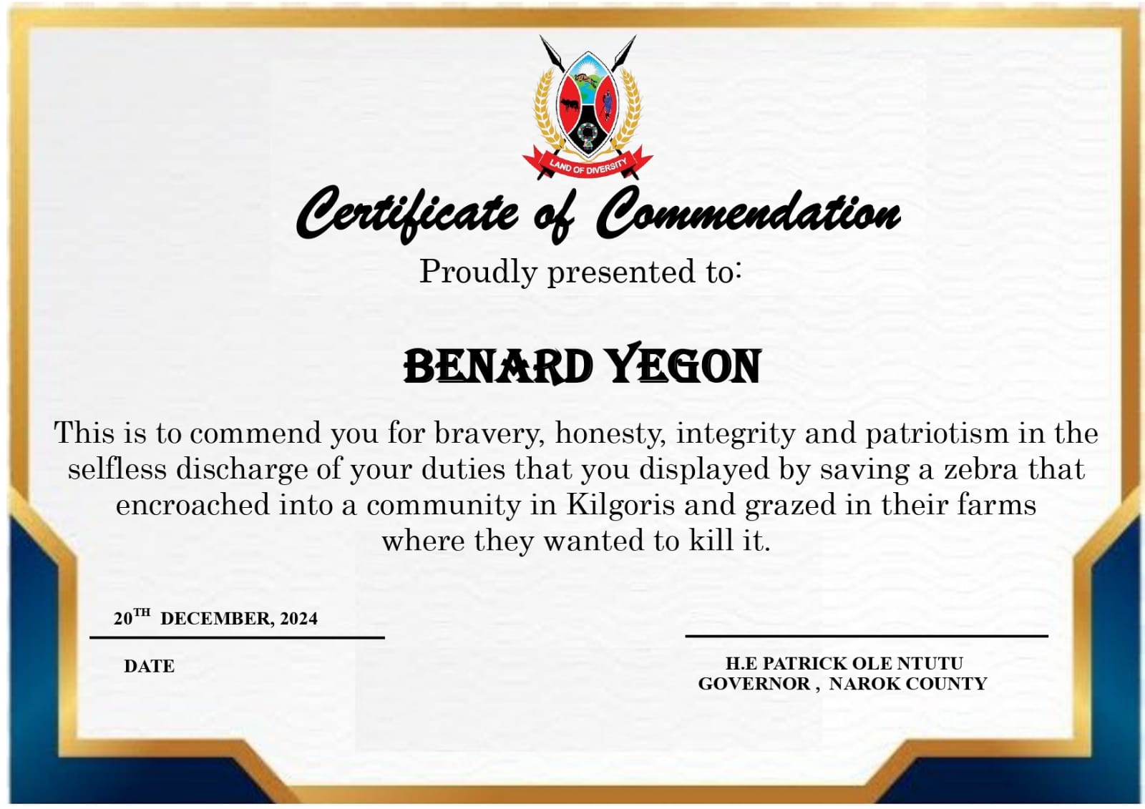

Slide 13
05.
STEPHEN MINIS
This is to commend you for your gallant act of management, innovation and steering the implementation of the Maasai Mara Game Reserve Management Plan for the year 2023-2024.

Slide 14
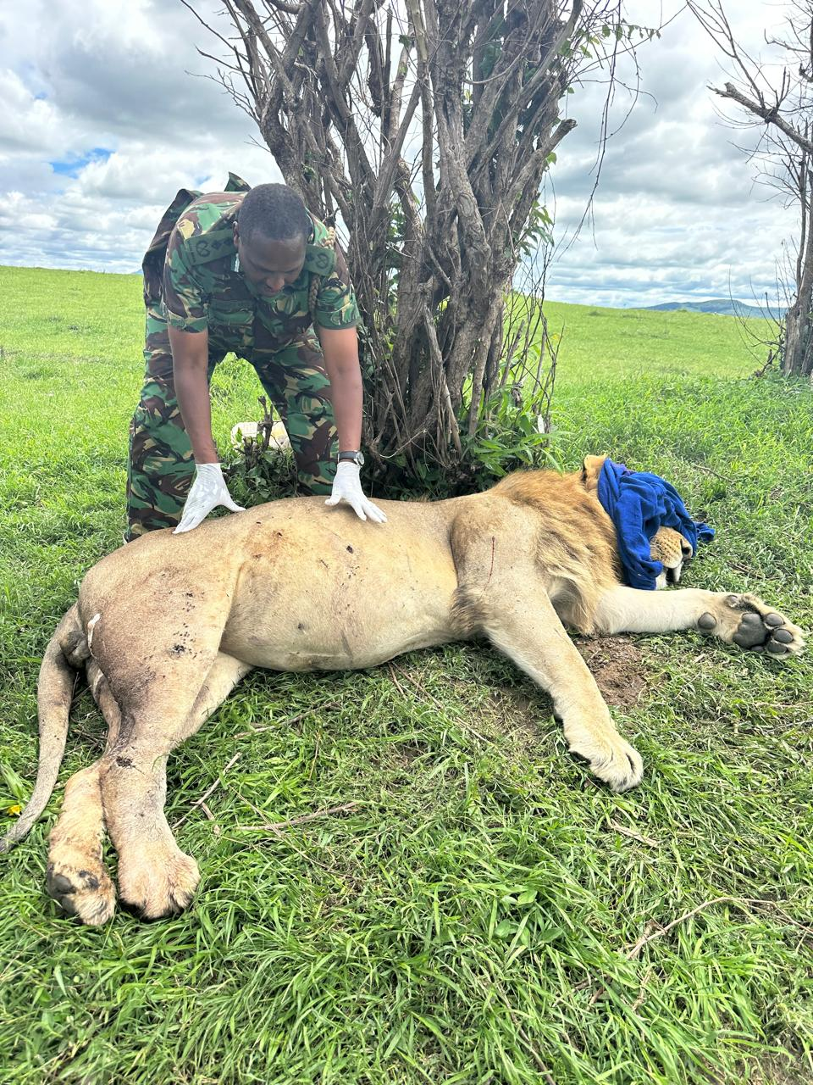
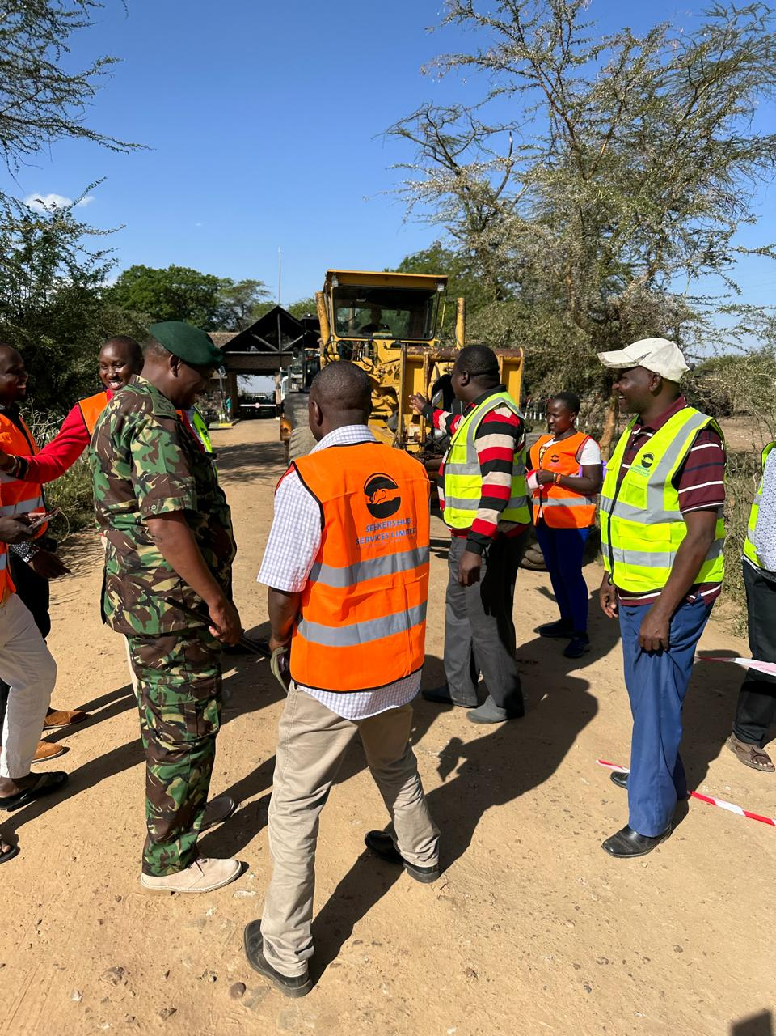

Slide 15
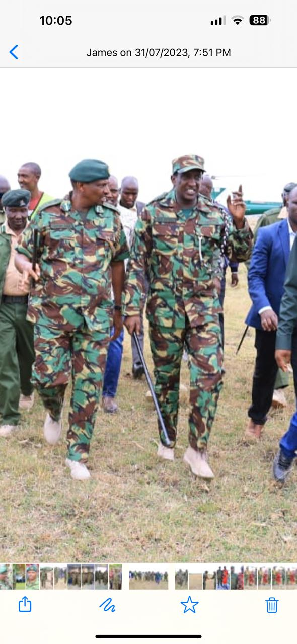
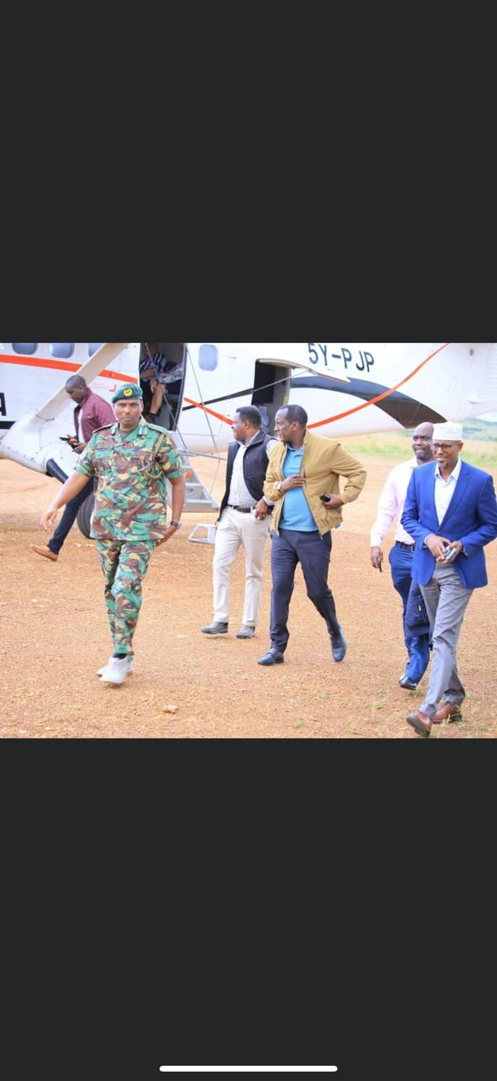

Slide 16
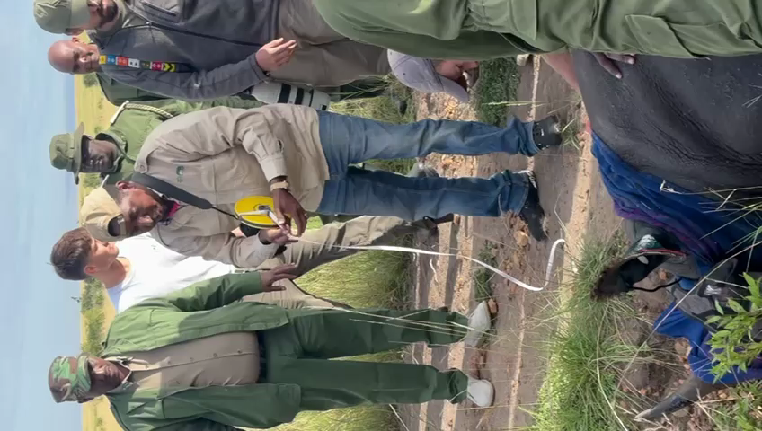

Slide 17
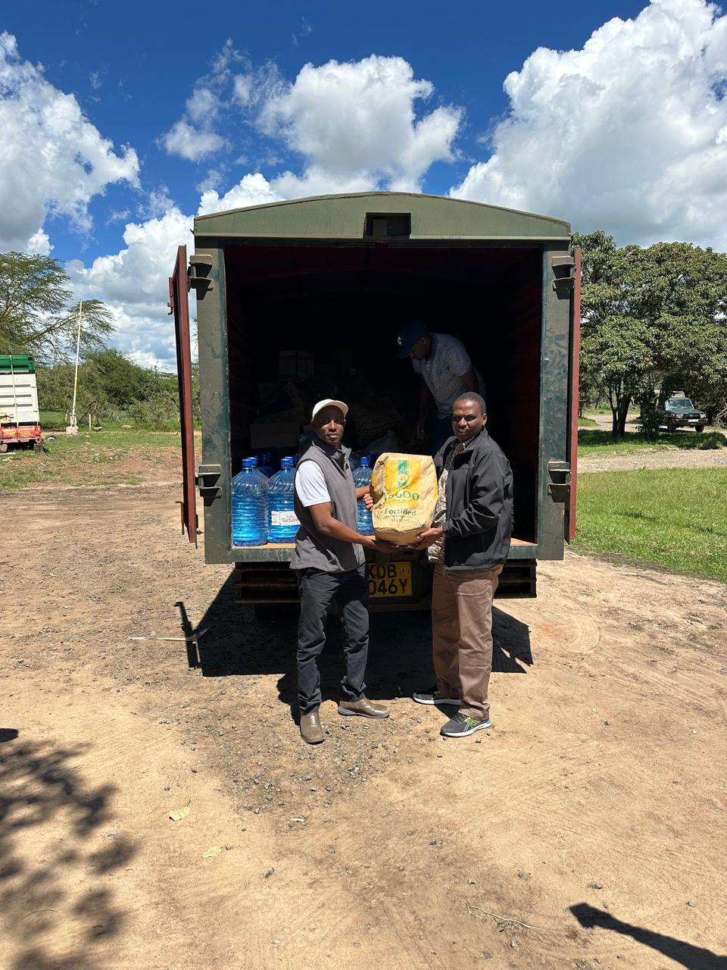
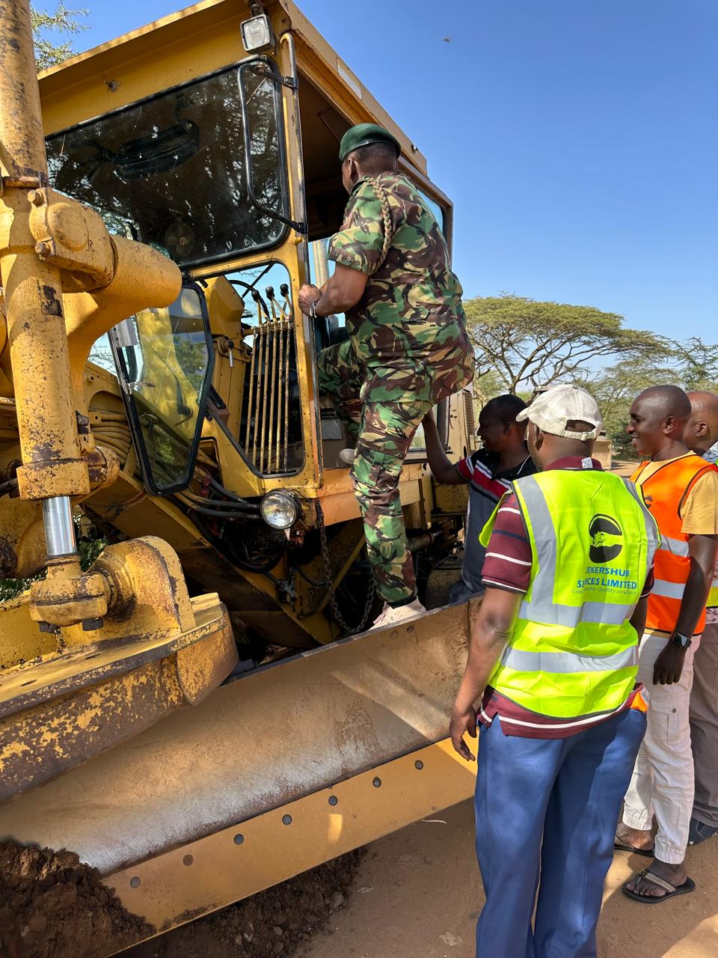

Slide 18
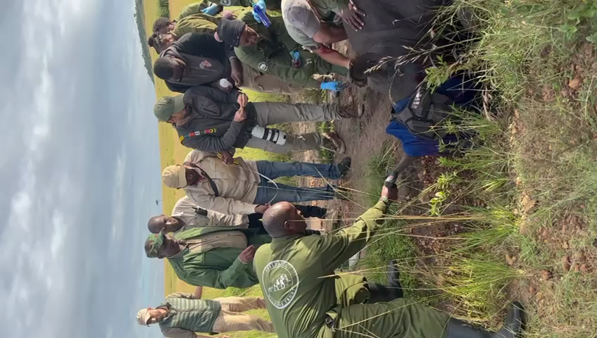

Slide 19
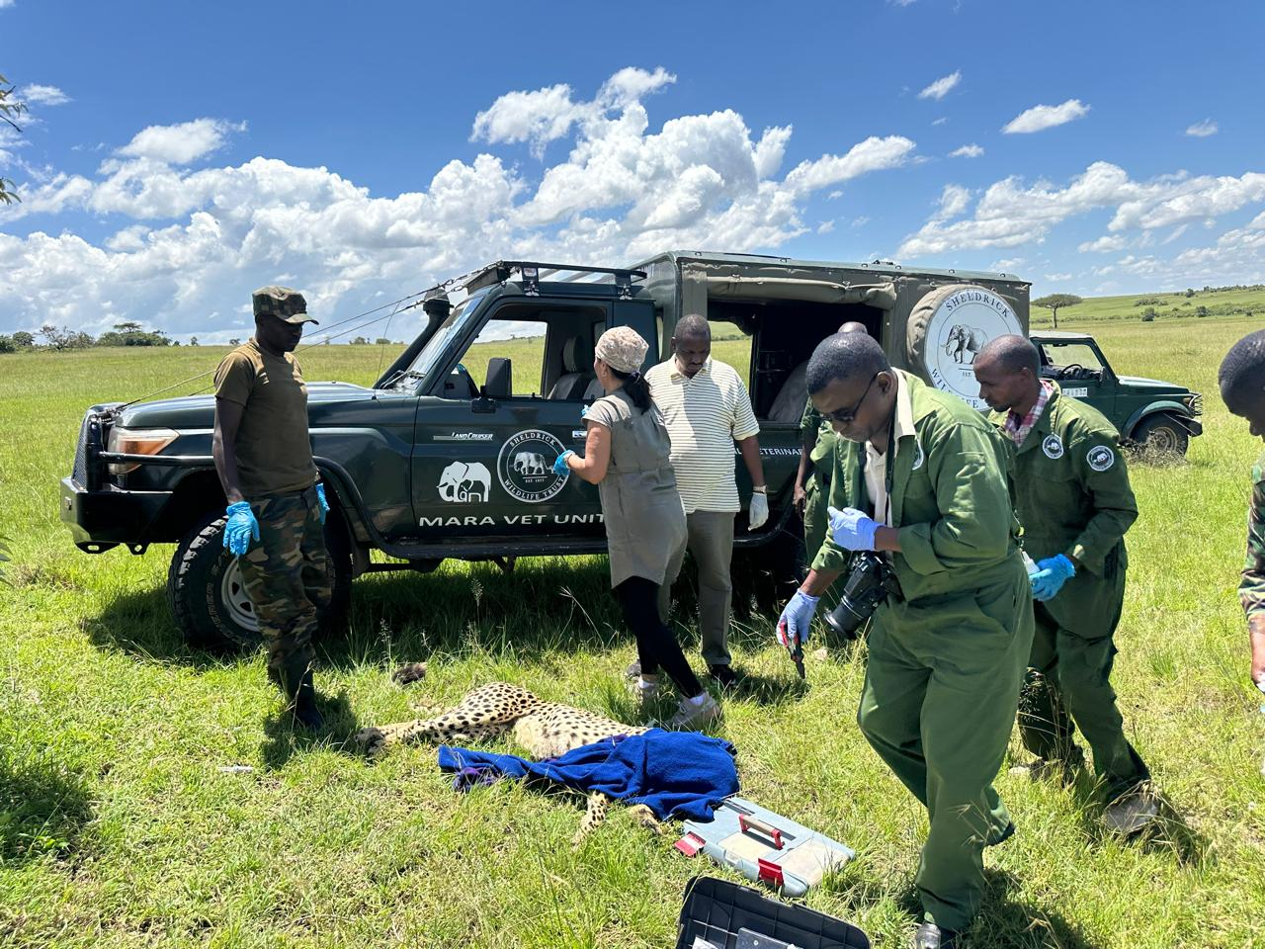
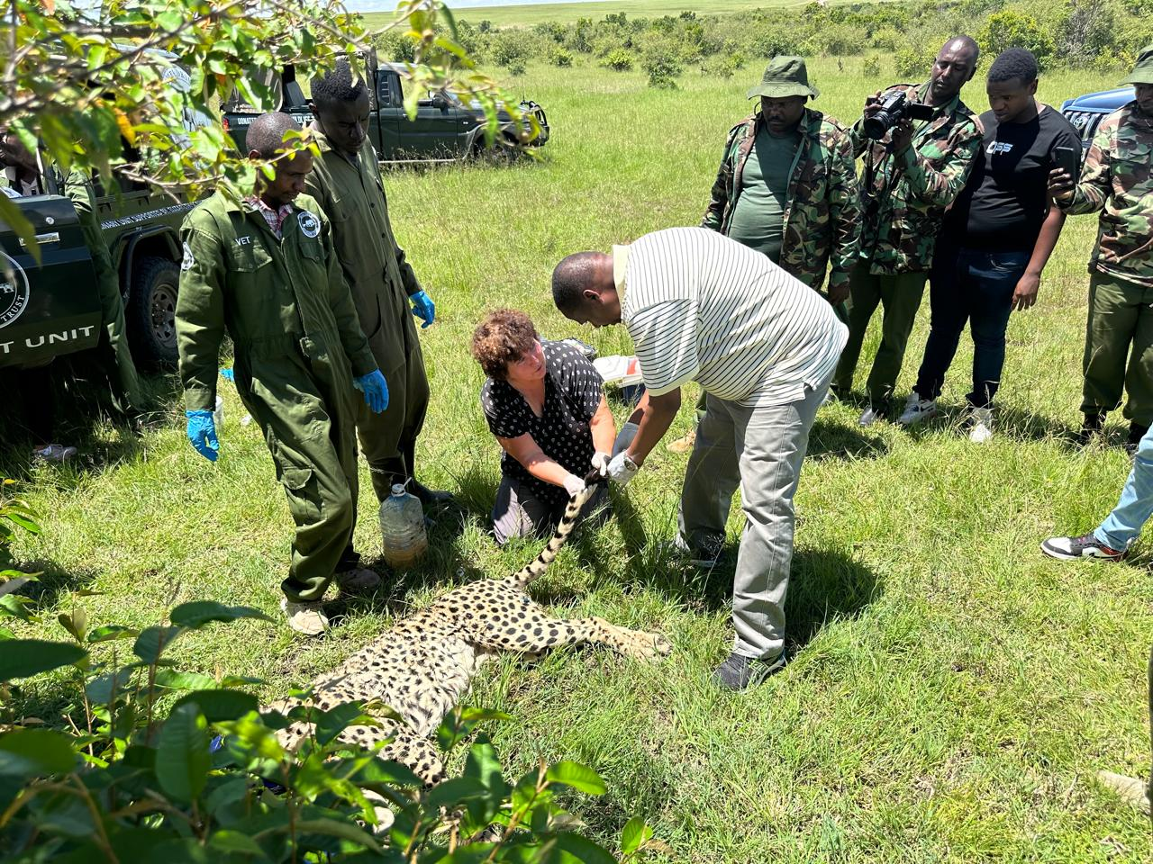

Slide 20
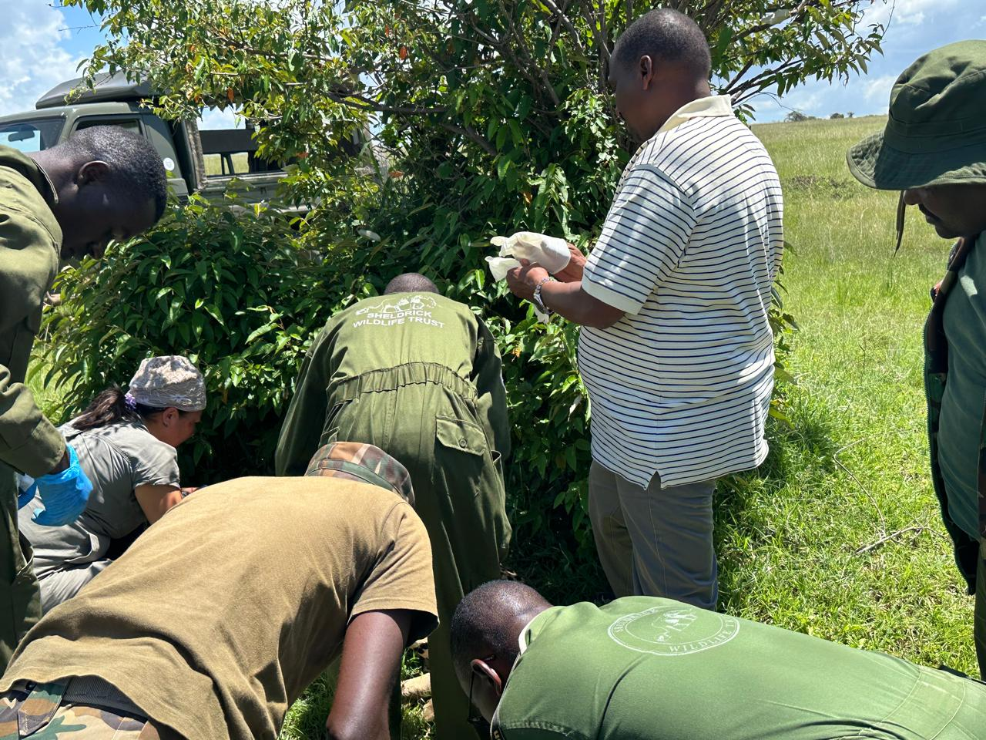

Slide 21
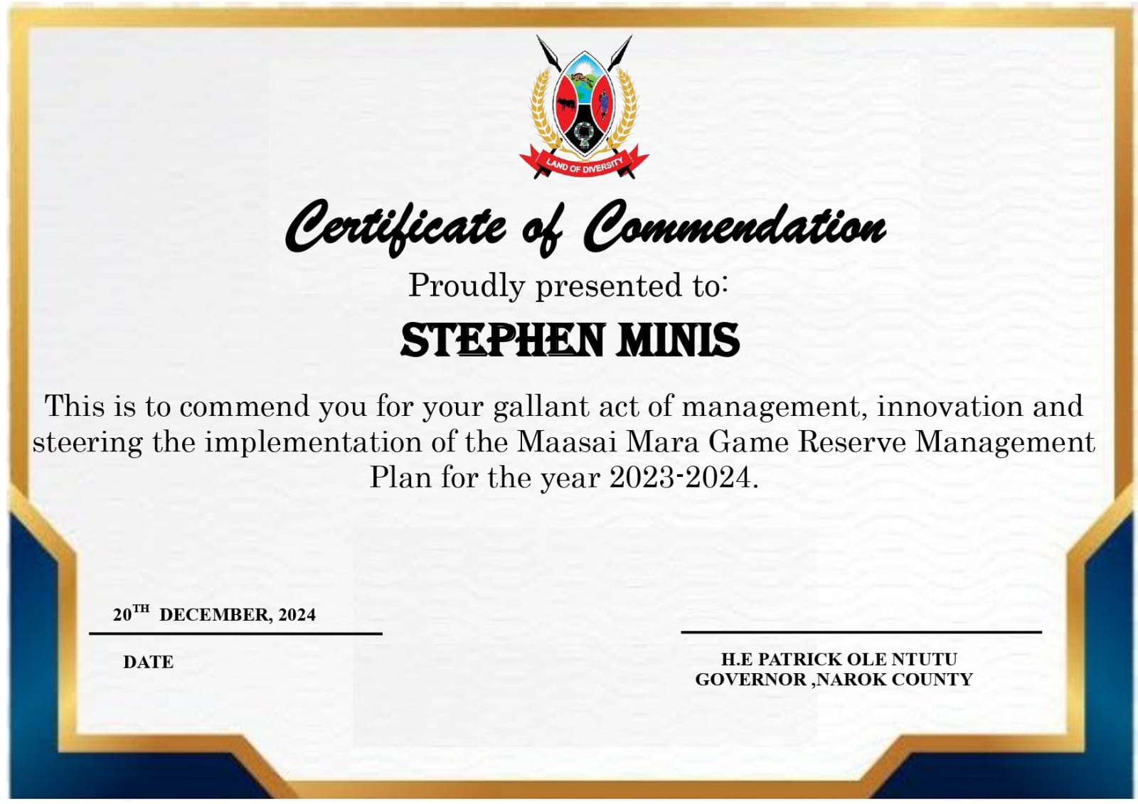

Slide 22
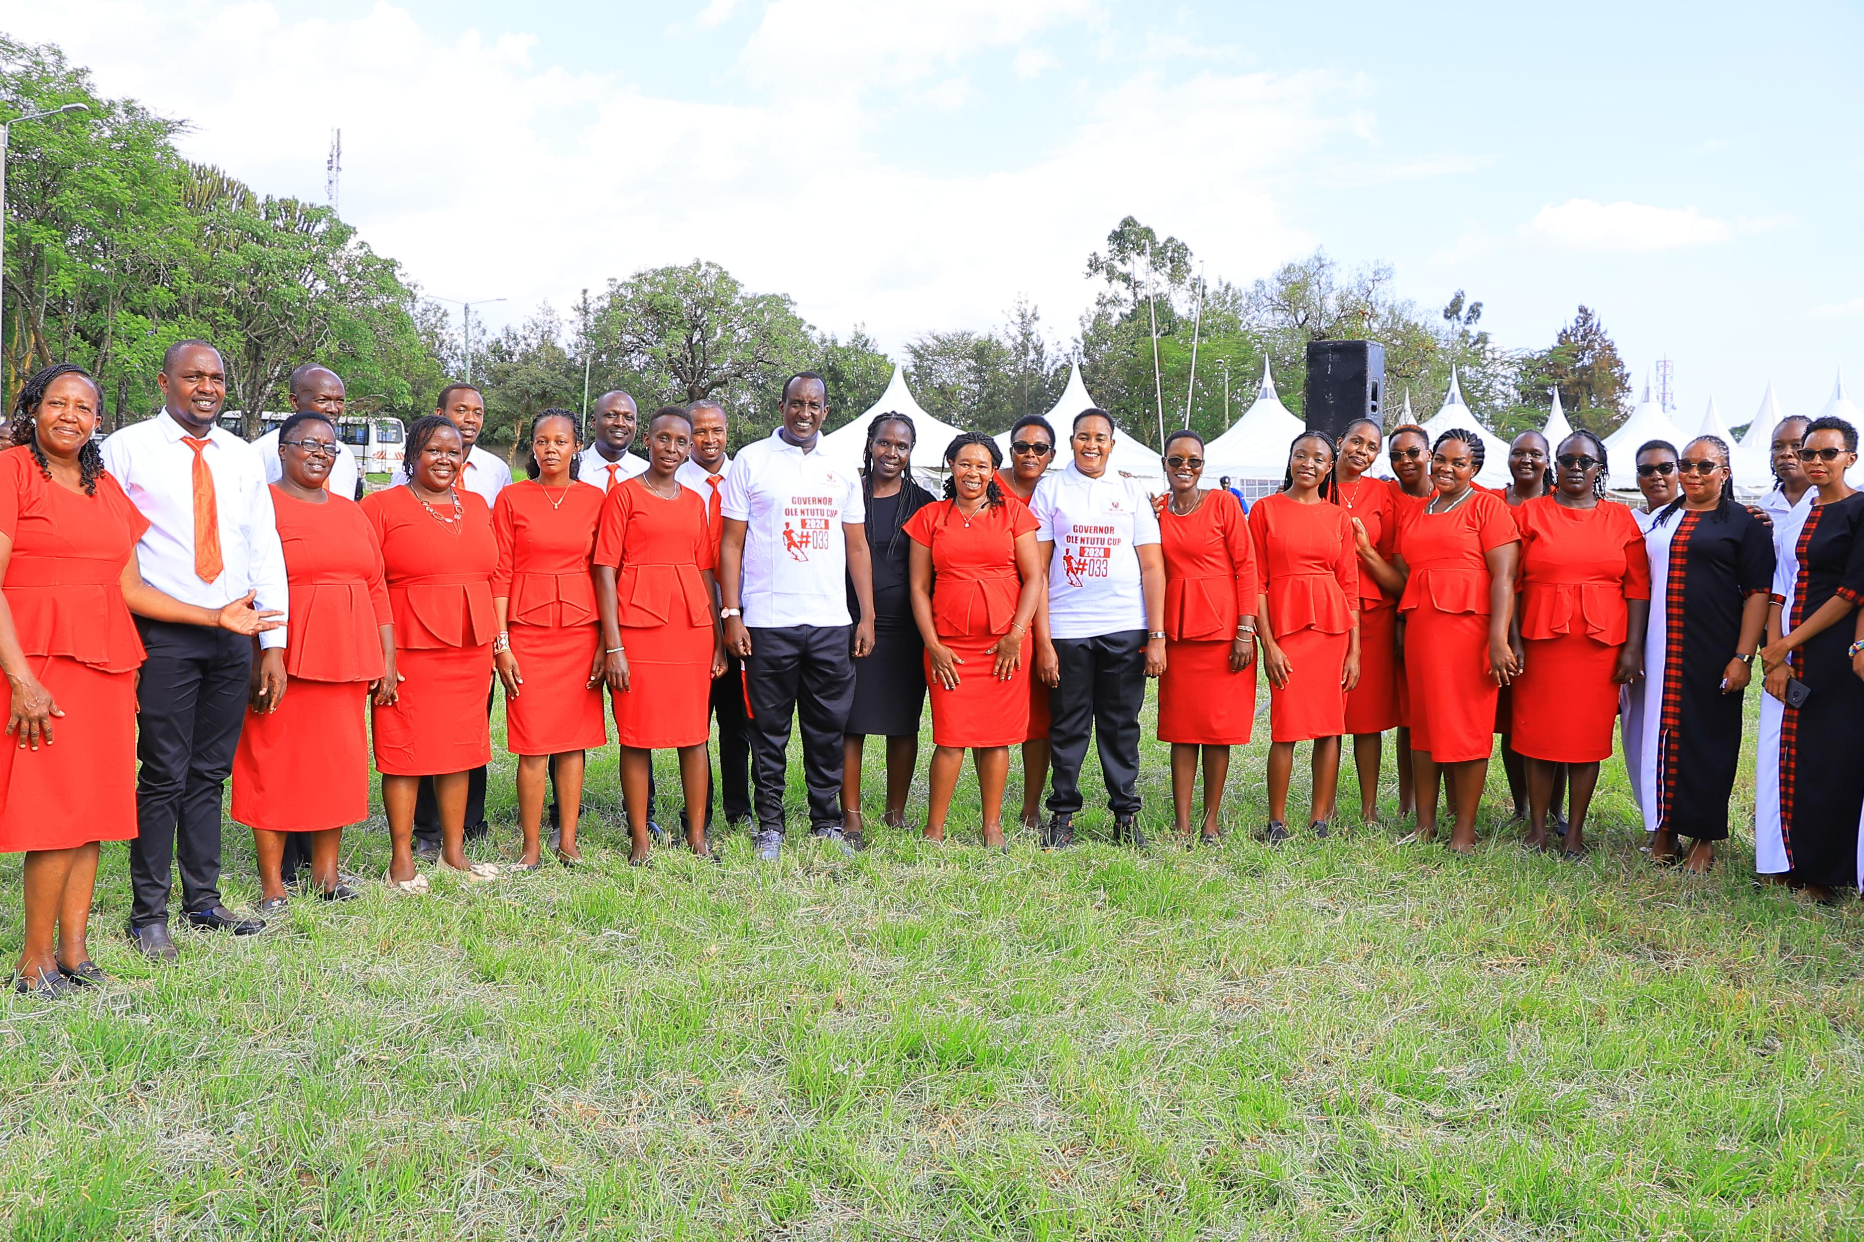
06.
NAROK COUNTY CULTURAL DANCERS
This is to commend you for your outstanding performance in the Kenya Inter County Sports and Cultural Association (KICOSCA) Games, 2024.

Slide 23


Slide 24
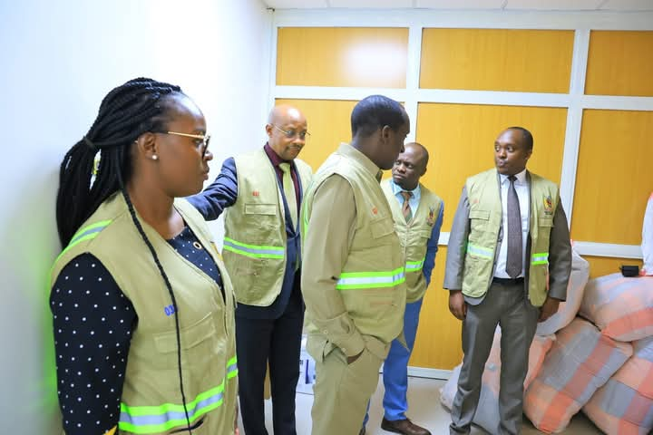
07.
COUNTY REVENUE UNIT
This is to commend you for your outstanding performance in improvements in Revenue Collection in Narok County Government for the financial year 2023-2024.

Slide 25
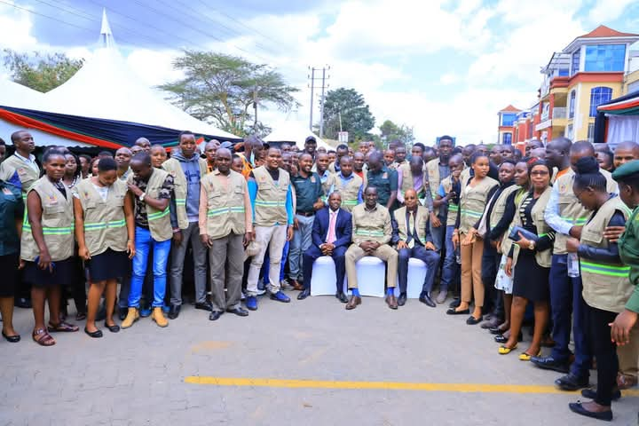
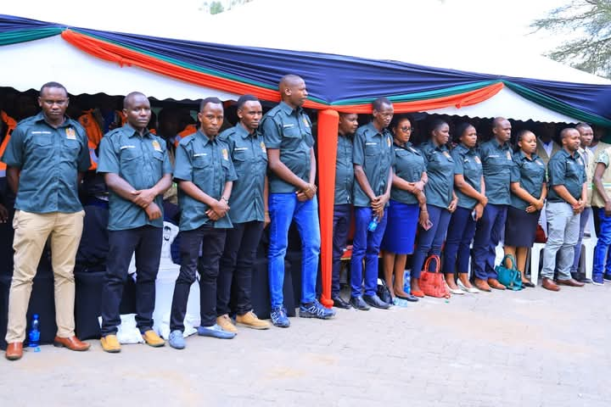

Slide 26
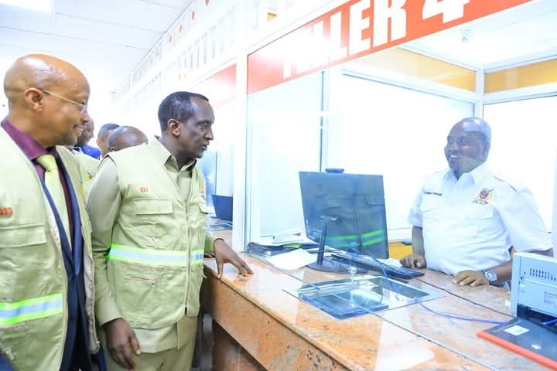

Slide 27


Slide 28
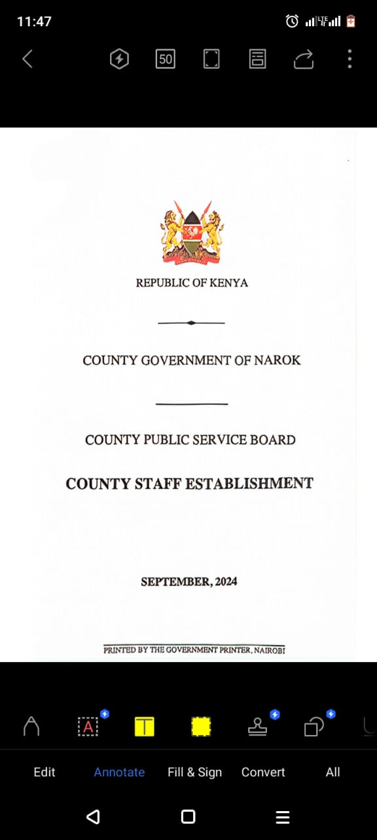
LAUNCH OF THE COUNTY STAFF ESTABLISHMENT

Slide 29

LAUNCH OF THE COUNTY PUBLIC SERVICE BOARD DISCIPLINE MANUAL

Slide 30
HAPPY HOLIDAYS

